Slide 1


SAP UI5 FIORI
Cascade Style Sheet
© Copyright 2021, ZaranTech LLC. All rights reserved.

Slide 2

Disclaimer
2
This presentation, including examples, images, and references are provided for informational purposes only.
Complying with all applicable copyrights laws is the responsibility of the user.
Without limiting the rights under copyright, no part of this document may be reproduced, stored or introduced into a retrieval system, or transmitted in any form or by any means.
Credits shall be given to the images taken from the open-source and cannot be used for promotional activities.
© Copyright 2021, ZaranTech LLC. All rights reserved.

Slide 3
Agenda
3
External Style Sheet
Font Properties and CSS Comments
Box model, padding, border, and margin
Classes &Div and Span
Working with colors and Background Colors
IDs, Child Selectors, Pseudo Classes
Styling links & styling lists
Rounded Corners
Linear Gradient and Float & Clear
New tags for the layout
© Copyright 2021, ZaranTech LLC. All rights reserved.

Slide 4
External Style Sheet
2
An external stylesheet is a standalone .css file that is linked from a web page.
It can be created once and the rules applied to multiple web pages.
All the styles that need to be used on a website can be declared in the external style sheet.
The file is saved with a .css extension and saved to any directory that can be accessed by the web pages using it.
‹#›

Slide 5
Font Properties
2
font-style : used to make a font italic or oblique.
font-variant : used to create a small-caps effect.
font-weight : used to increase or decrease how bold or light a font appears.
font-size/line-height : specifies the font size and the line-height.
font-family : specifies the font family.
‹#›

Slide 6
CSS Comments
2
Comments are used to explain the code.
It also helps when you edit the source code at a later date.
CSS uses the same "block comment" syntax as the C-like languages .
A CSS comment is placed inside the <style> element, and starts with /* and ends with */:
‹#›

Slide 7
Box model, Padding, Border, and Margin
2
Box model - In CSS, the term "box model" is used for design and layout. The CSS box model is essentially a box that wraps around every HTML element.
Padding - In CSS, inside of any defined borders, to generate space around an element's content, padding properties are used.
Border - The CSS border properties allows to specify the style, width, and color of an element's border.
Margin - The margin property in CSS sets the margin area on all four sides of an element.
‹#›

Slide 8
Classes
2
A class is a group of elements that are the same/similar.
A class can have as many elements as possible
Each element can be the member of multiple classes.
Every class has CSS attributes (like color and font-size) that are specific to that class.
‹#›

Slide 9
Div and Span
2
Both the Div tag and the Span tag have a very important role in CSS and web design.
They are used to group and structure a document, and assign properties to specific parts of the page.
They are used in close conjunction with the CLASS and ID attributes.
The tags used for Div is <div> and for Span is <span>.
‹#›

Slide 10
Working with Colors
2
Hexadecimal (or hex) values are used to specify colors in CSS.
Hex values are actually just a different way to represent RGB values.
Instead of using three numbers between 0 and 255, six hexadecimal numbers are used.
Hex numbers can be 0-9 and A-F.
There are specific code of colors.
‹#›

Slide 11
Background Images
2
In HTML, background-image property sets one or more background images for an element.
By default, a background-image is placed at the top-left corner of an element, and repeated both vertically and horizontally.
CSS also allows to add multiple background images for an element, through the background-image property.
11

Slide 12
IDs, Child Selectors, Pseudo Classes
2
IDs - The id selector uses the id attribute of an HTML element to select a specific element. The id of an element is unique within a page, so the id selector is used to select one unique element.
Child Selectors - It is used to match all the elements which are child of a specified element. The element > element selector selects those elements which are the children of specific parent.
Pseudo Classes - A CSS pseudo-class is a keyword added to a selector that specifies a special state of the selected elements.
12

Slide 13
Styling Links & Styling Lists
2
Styling Links - Links can be styled with any CSS property (e.g. color, font-family, background, etc.).
The four links states are:
a:link - a normal, unvisited link
a:visited - a link the user has visited
a:hover - a link when the user mouses over it
a:active - a link the moment it is clicked
Styling List - The styling list defines the type of list by setting the content of each marker, or bullet, on the list.
13

Slide 14
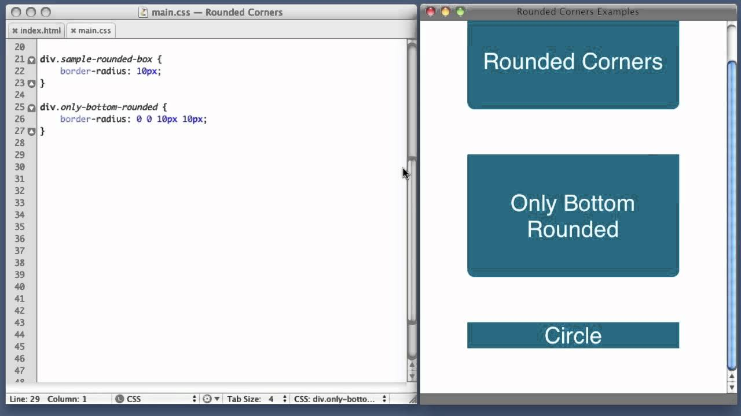
Rounded Colors
2
This property allows to add rounded corners to elements.
Rounded corners are more effective for maps and diagrams.
14

Slide 15
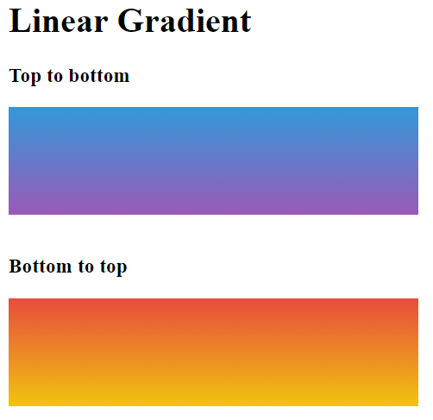
Linear Gradient
2
The linear-gradient() CSS function creates an image consisting of a progressive transition between two or more colors along a straight line.
Its result is an object of the <gradient> data type, which is a special kind of <image> .
15

Slide 16
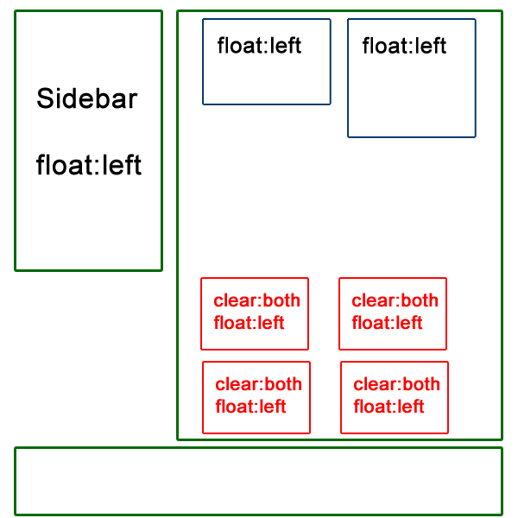
Float and Clear
2
Float - In CSS, the float property specifies how an element should float.
Clear - In CSS, clear property specifies what elements can float beside the cleared element and on which side.
16

Slide 17

New tags for the layout
2
Let us look at some new tags for layout
17

Slide 18
Thank you
Subscribe to our Channel for more Informative Videos.
https://www.youtube.com/user/ZaranTech

